Slide 1
Direct Marketing Campaigns
Portuguese Banking Institution
Group 5
Tang Shiwei
Paris Siripatana
Jonathan Then Tian Meng
Liu Zhiyang
Ku Chin-Chen

Slide 2
Table of contents
01.
02.
03.
Dataset Description Problem Statement
Data Pre-processing Training & Testing Procedure
Logistic Regression Random Forest
04.
05.
06.
Voting for ML Methods Multi-Layer Perceptron
Naïve Bayes SVM
Summary Future Improvements

Slide 3
Dataset Description Problem Statement
01

Slide 4



Dataset Description
Direct marketing campaigns of a Portuguese banking institution from May 2008 to November 2010
45211 instance with 16+ features
In order to assess if the product (bank term deposit) would be (or not) subscribed.
Y: Has the client subscribed a term deposit? (0-No, 1-Yes)
Client Profile
Marketing Campaigns
Other Attributes
1 - age 2 – job
3 – marital status
4 - education level
5 – default status​
6 – balance​
7 – housing loan​
8 - personal loan​
9 - communication type
10 - last contact day 11 - last contact month
12 - duration: last contact duration
13 - number of campaign before
14 - passed days from previous campaign
15 - number of contacts performed
16 - outcome of the previous campaign

Slide 5
Data Pre-Processing Training & Testing Procedure
02

Slide 6
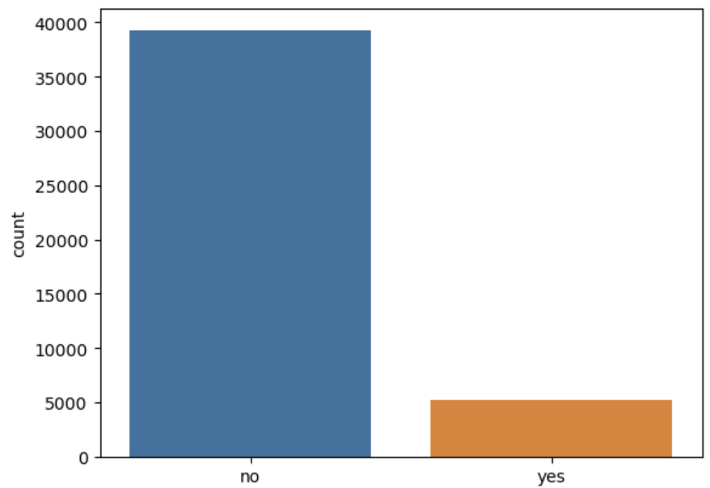
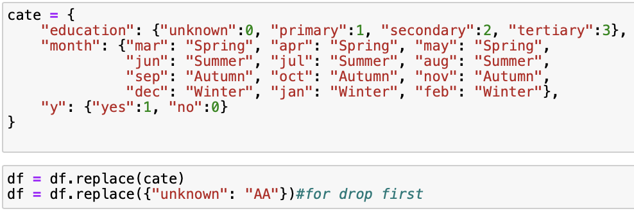
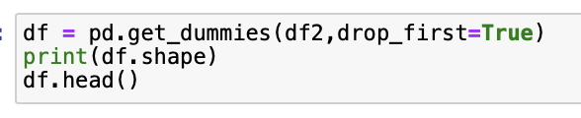
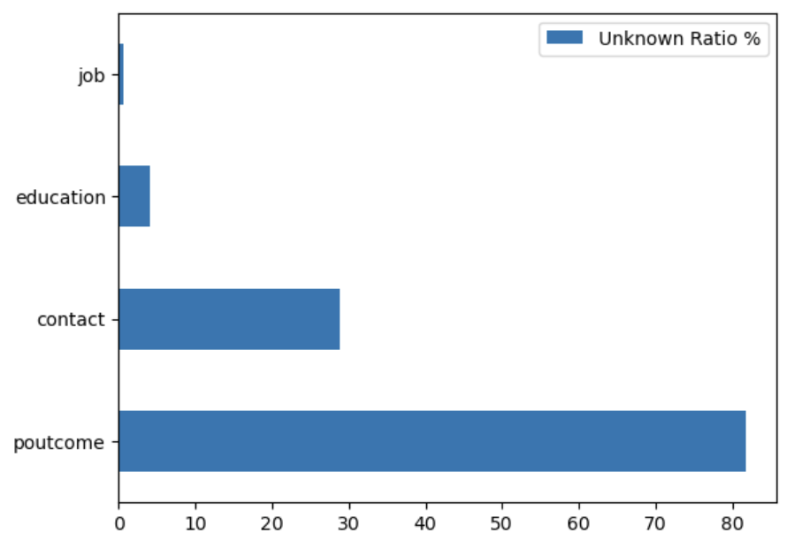
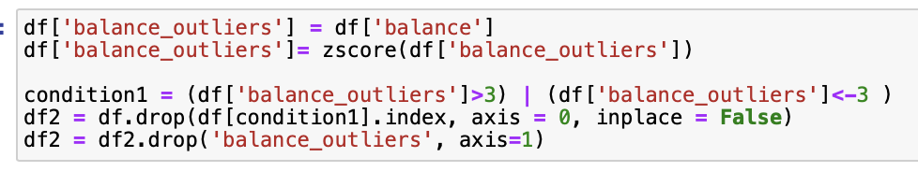
Imbalanced Data
Data Pre-processing
Encoding / Grouping months into seasons
13.15%
Unknown data
Remove Outliers by Z-score
Removed 745 observations in totals

Slide 7
Procedure
70%
Data
Train set
Cross-Validation
Scaling
(Standardization)
Resampling
(SMOTE)
Hyper Parameters Tuning
30%
Final Evaluation
Test set
Best model
Accuracy
ROC/AUC

Slide 8
Logistic Regression
03

Slide 9
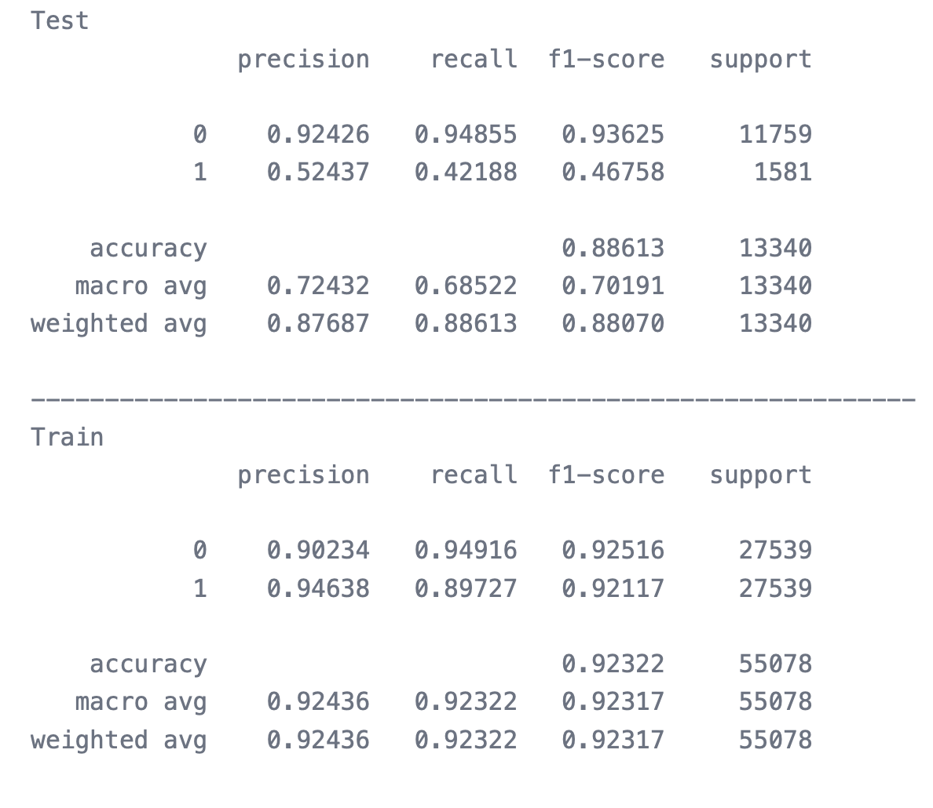
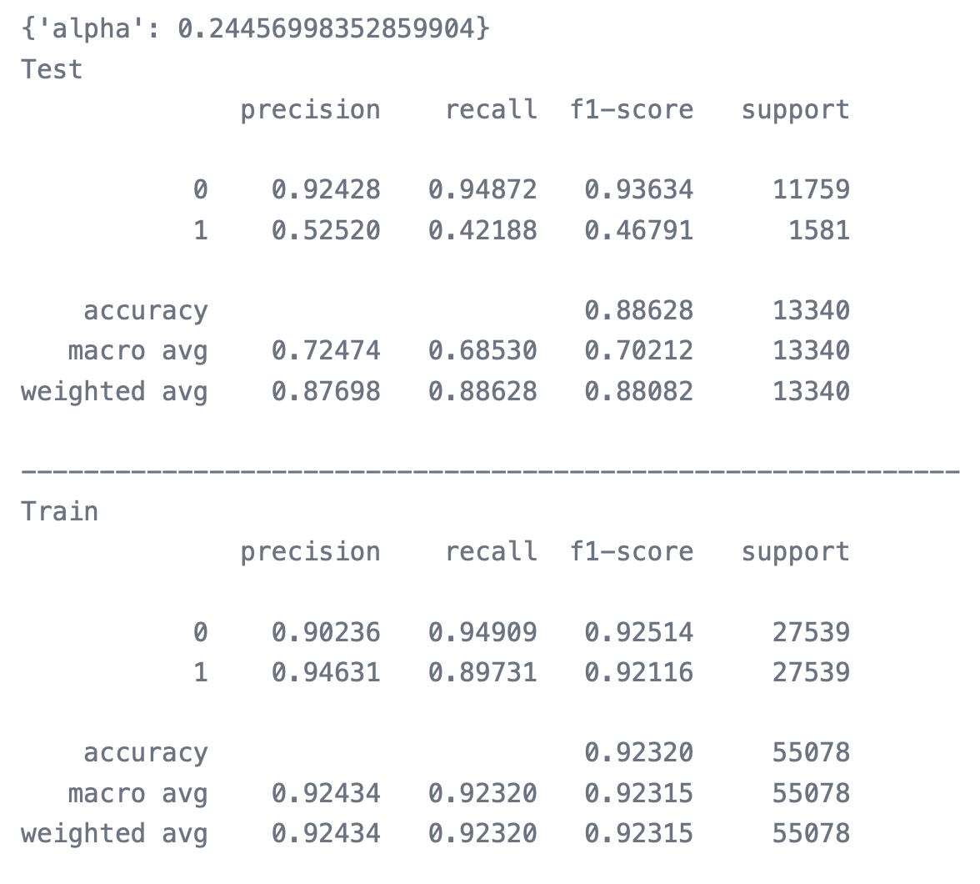
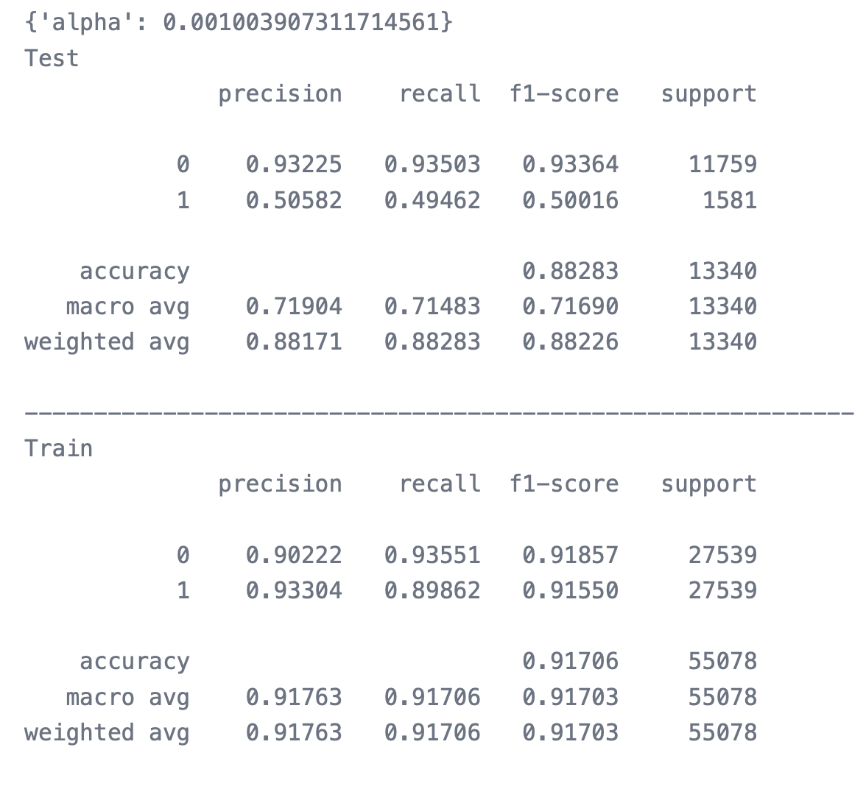
Models
Logistic
Ridge
Lasso

Slide 10
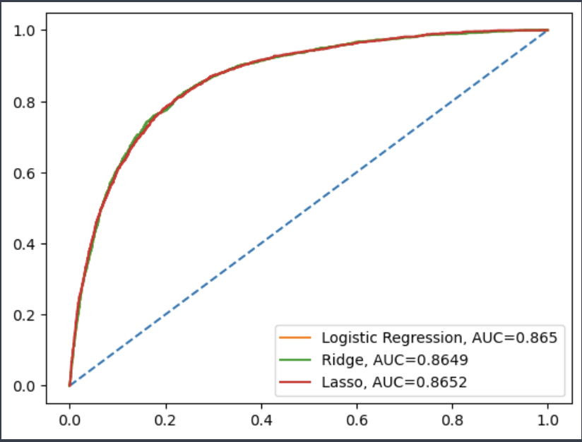
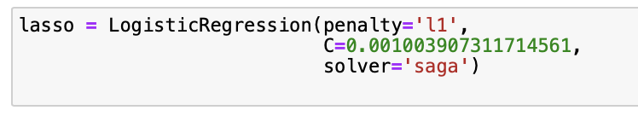
ROC & AUC
Best Model
Similar results for the 3 models
Lasso gives the best AUC of 0.8652

Slide 11
Random Forest
03

Slide 12
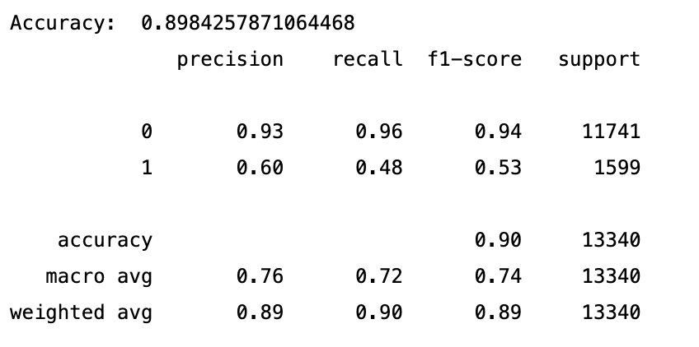
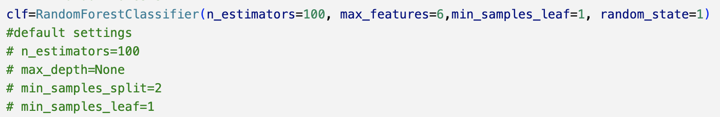
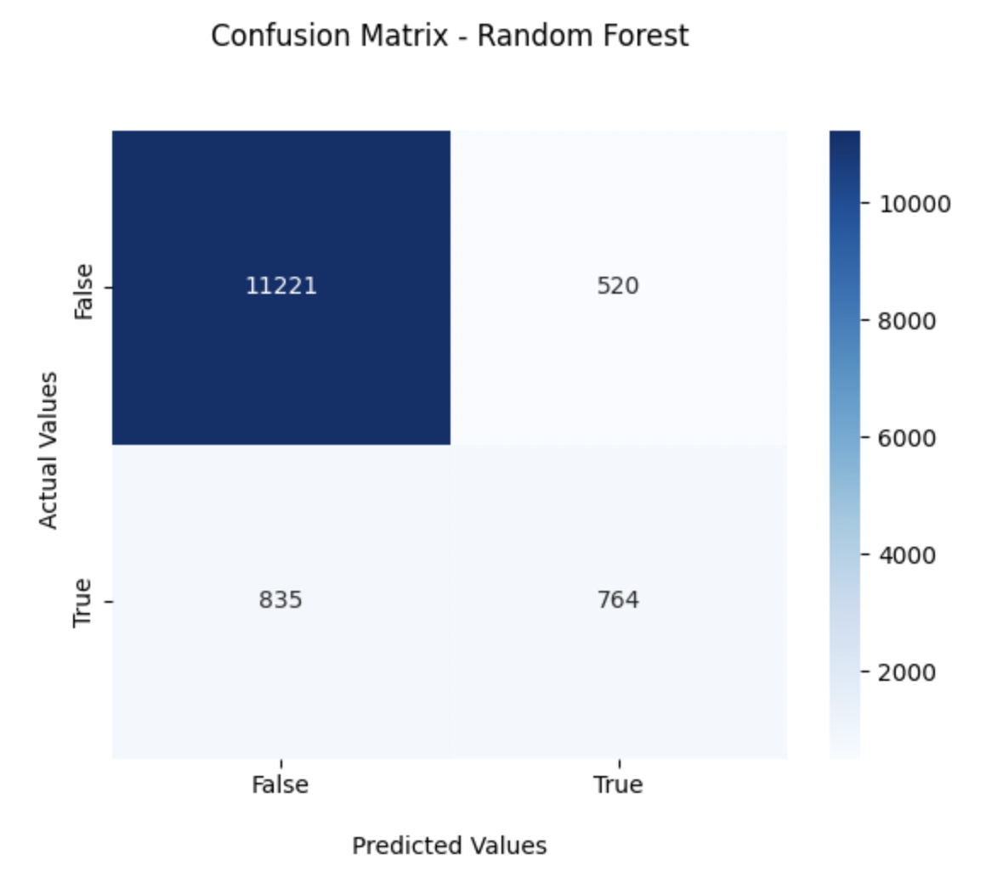
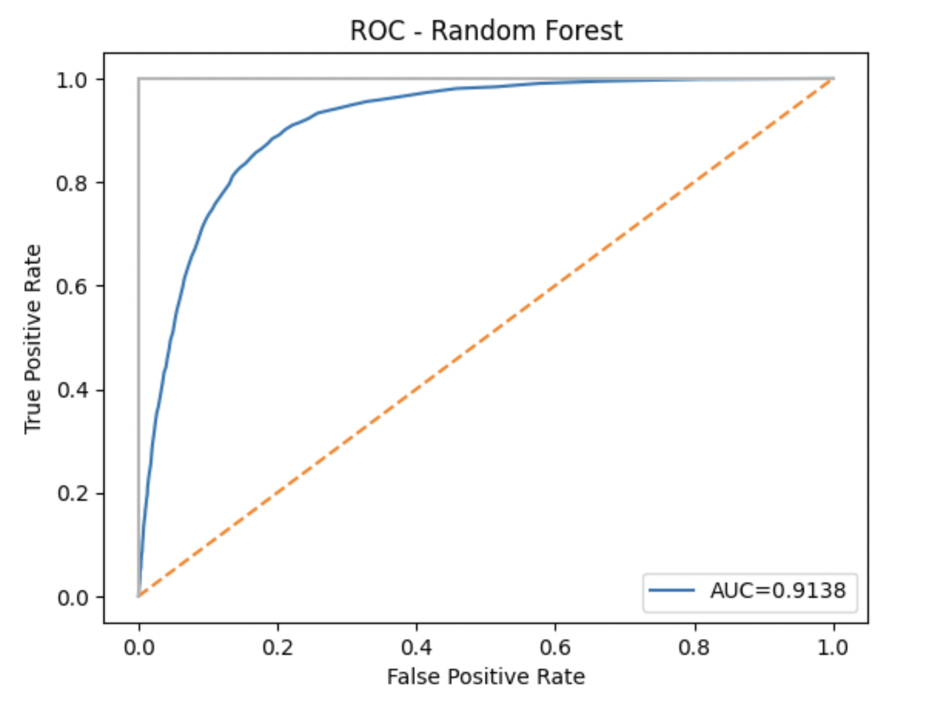
Random Forest
ACC | 0.8984
AUC | 0.9138
TPR | 0.4778
TNR | 0.9557
FPR | 0.0443
FNR | 0.5222
PPV | 0.5950

Slide 13
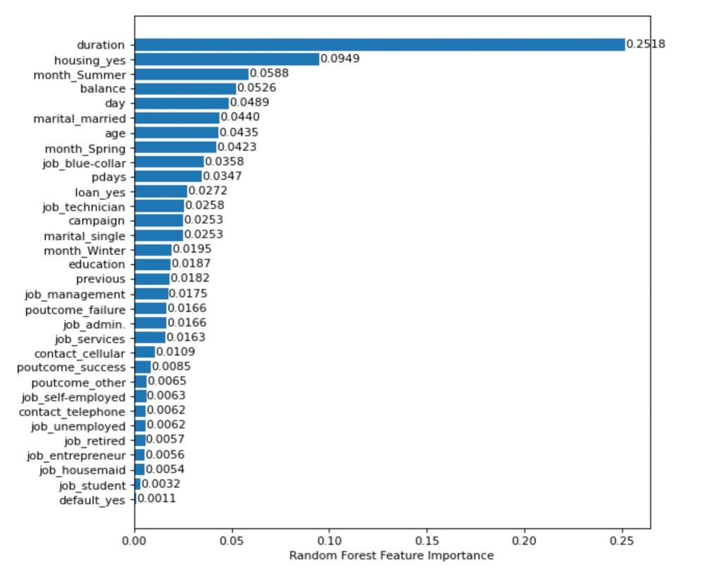
Features Importance
1. Among the 16 features (32 dummy features), the last contact duration, having housing loan and yearly balance are the most important variable.
2. Married customer with blue-collar job will have more possibility to subscribe the product.
3. Though the contacting duration is the most important, the marketing result is more relevant to customers' profile, instead of the marketing campaigns.

Slide 14
Naïve Bayes SVM
04

Slide 15
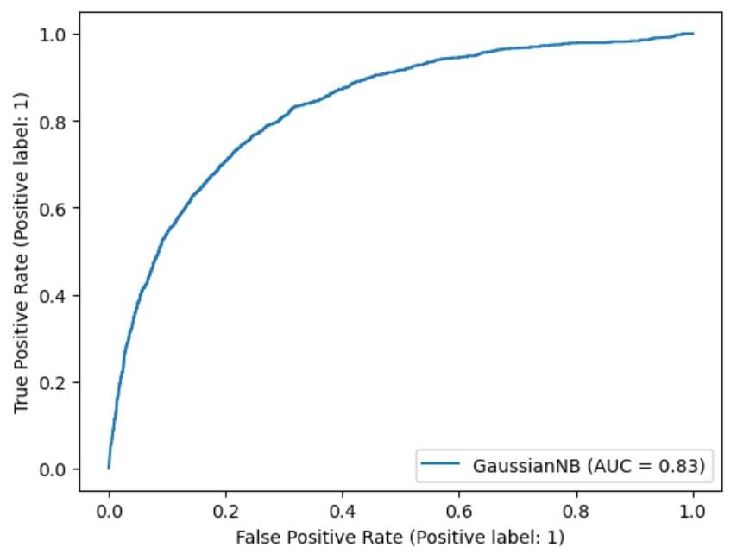
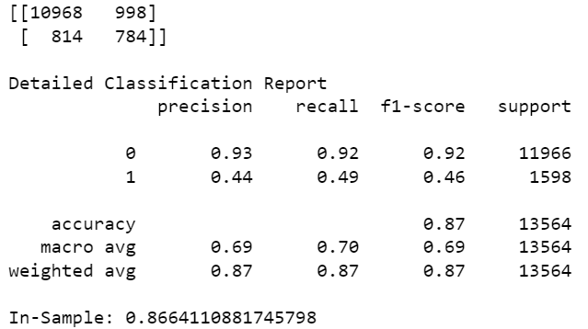
Naive Bayes
Accuracy: 0.86
ROC AUC: 0.83

Slide 16
Support Vector Machine
01
02
03
04
Use smaller dataset
Fit SVM model & 5-Fold CV
Determine the kernel type to be used
Determine the regularization parameter (C)

Slide 17
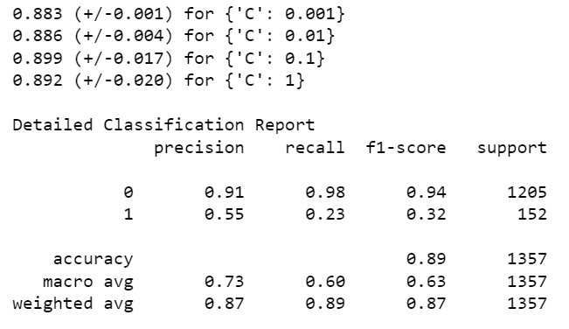
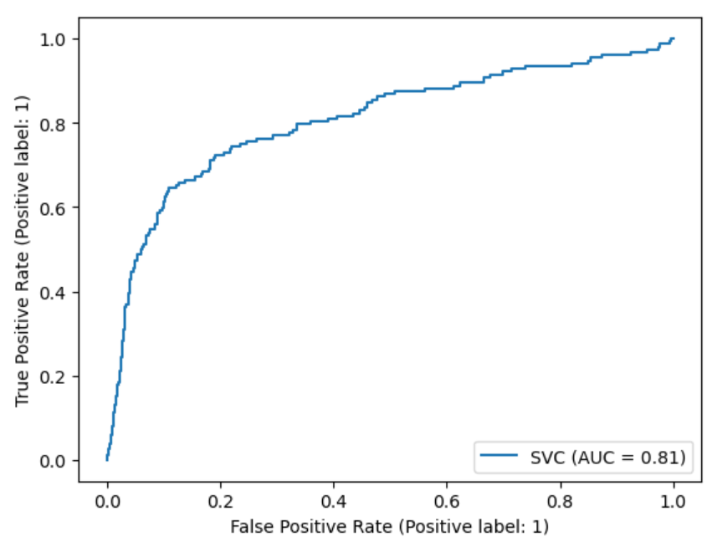
Support Vector Machine – Linear, 0.1
Accuracy: 0.90
ROC AUC: 0.81

Slide 18
Voting for traditional ML Methods
05

Slide 19
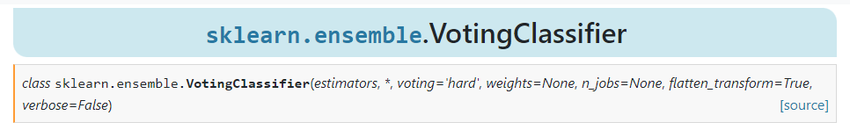
Voting methods from SKlearn
A voting ensemble (or a “majority voting ensemble“) is an ensemble machine learning model that combines the predictions from multiple other models. It is a technique that may be used to improve model performance, ideally achieving better performance than any single model used in the ensemble.
Limitation: Not suitable for deep learning to some extent, since the model from deep learning is usually computationally heavy, which makes cross-validation very hard. Therefore, MLP(Multiple layer perceptron) will be a separate part.

Slide 20
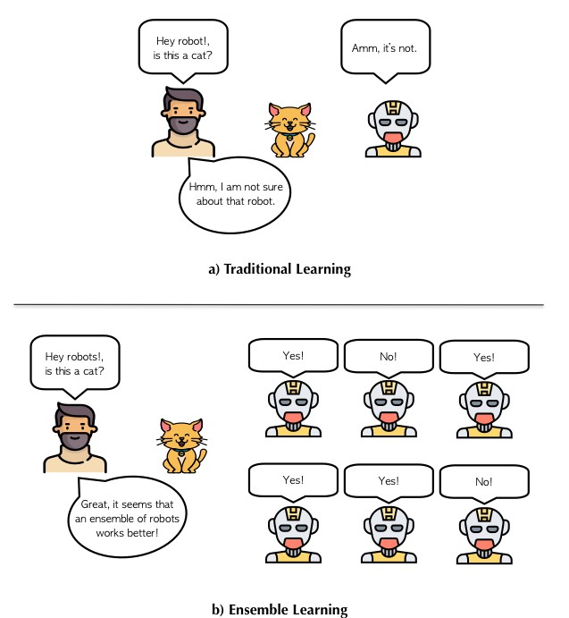
Voting methods from SKlearn

Slide 21
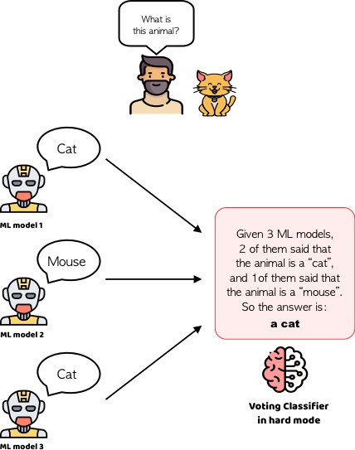
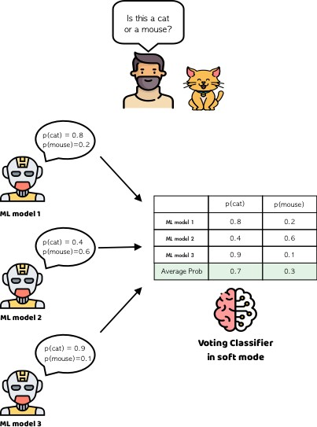
Voting methods from SKlearn

Slide 22
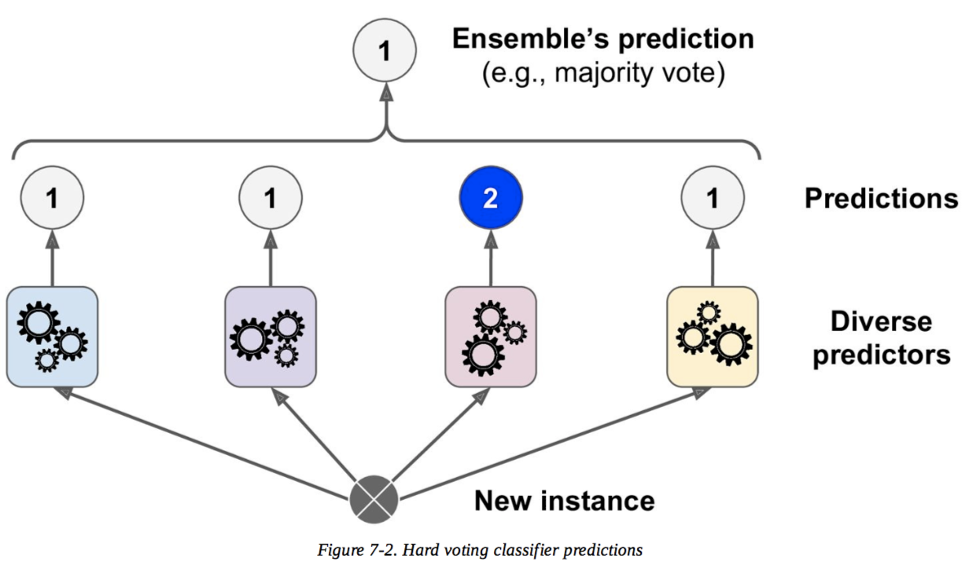
Voting methods from SKlearn

Slide 23
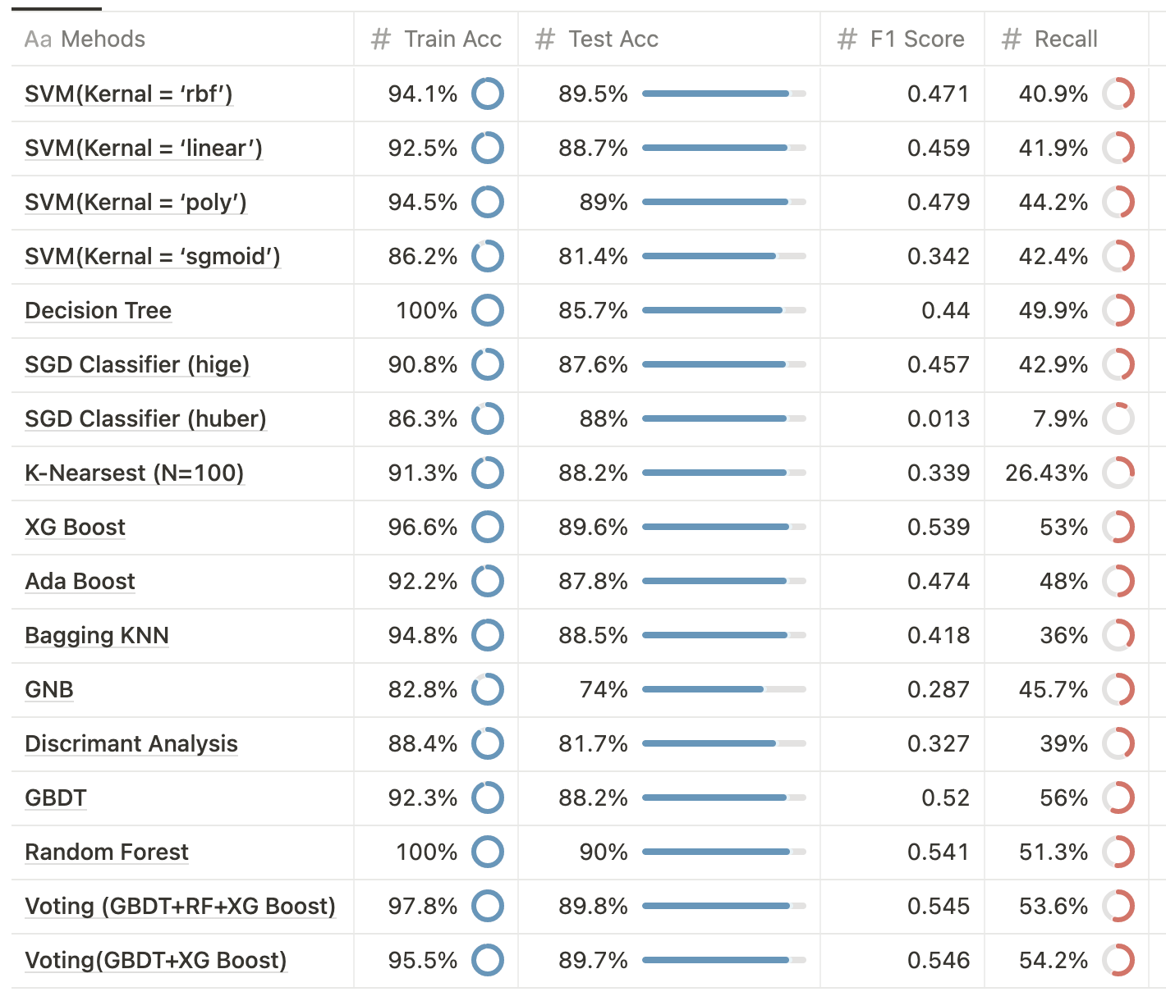
Compare different traditional ML methods
Test Accuracies are almost the same but F1 scores and recalls vary.
Recall is important！

Slide 24
Why Recall?
In order to assess if the product (bank term deposit) would be (or not) subscribed.
To maximize the profit, we don’t what to miss any potential customer!
Type I error is acceptable.
Type I error: False alarm, Overestimation, False Positive
Type II error: Miss, Underestimation, False Negative

Slide 25
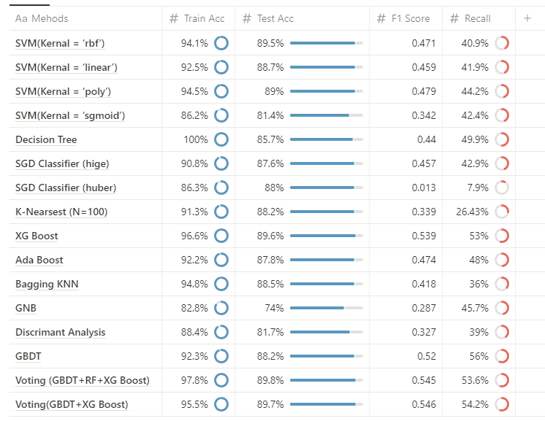
Compare different traditional ML methods
The recall of Voting (GBDT + XG Boost) is the best.

Slide 26
Multi-Layer Perceptron
05

Slide 27
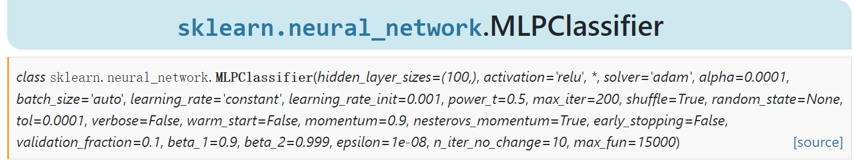
MLP Classifier from SKlearn
01
02
03
04
Balance Data
Using SMOTE
Tune the
hyperparameters
Build the MLP Model
Get the results

Slide 28
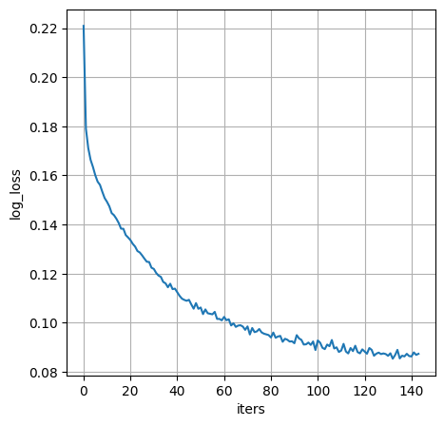
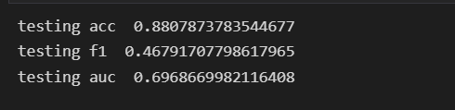
MLP Classifier from SKlearn
Hyperparameters | Value
alpha | 0.01
Hidden_layer _sizes | (128,64,32,16,8)
Solver | Adam
Batch_size | 64

Slide 29
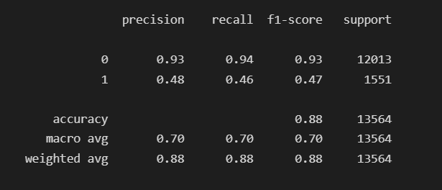
MLP Classifier from SKlearn
Hyperparameters | Value
alpha | 0.01
Hidden_layer _sizes | (128,64,32,16,8)
Solver | Adam
Batch_size | 64
The accuracy is satisfying
The AUC score is not too bad
The F-1 score is a disaster

Slide 30
MLP Classifier from SKlearn
The reason for this f-1 score mainly consists of the following three:
The MLP model can be tuned further
The test set is highly imbalanced with 12013 negative labels and 1551 positive labels
The SMOTE provides duplicated and useless information for the classifier to learn

Slide 31
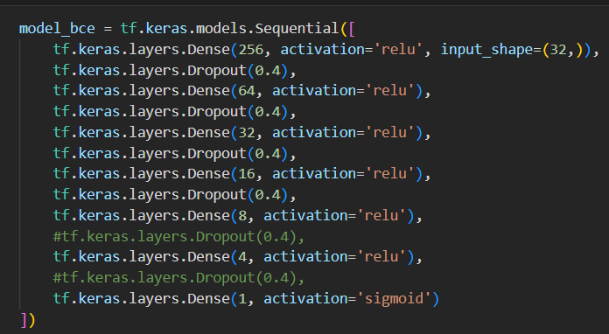
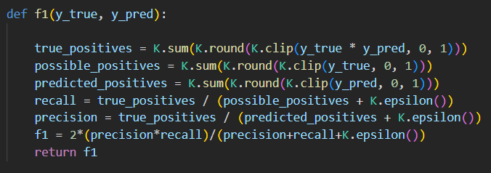
MLP from Tensor flow
—Using binary crossentropy
The MLP model can be tuned further.
Introduced the Tensor flow to tune the model further
Introduced the f-1 score during training
Hyperparameters | Values
loss | binary_crossentropy
optimizer | rmsprop
batch_size | 128
epochs | 9

Slide 32
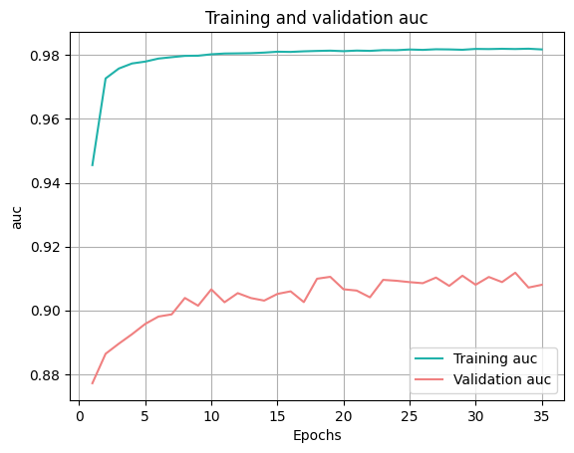
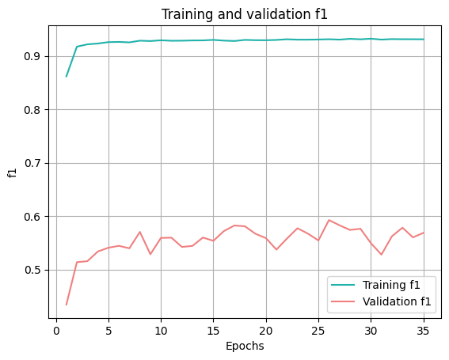
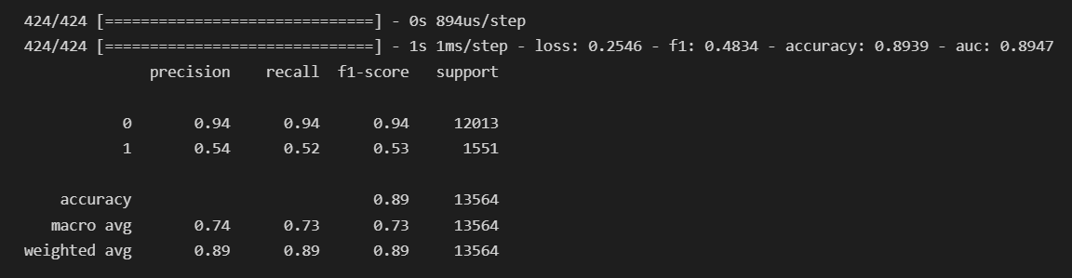
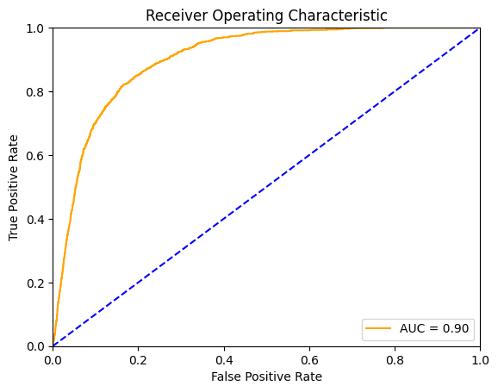
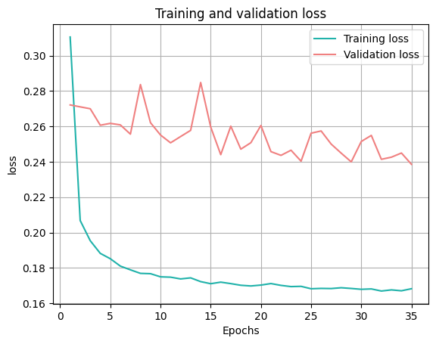
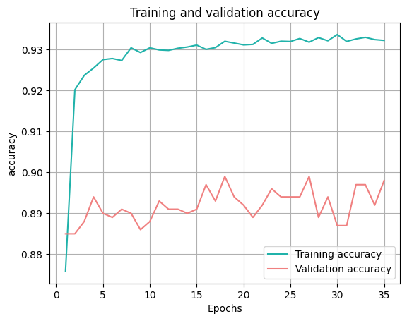
MLP from Tensor flow
—Using binary cross entropy
Comparing with the sklearn model ,
we have some progress

Slide 33
MLP from Tensor flow
—Using Focal Loss
We are not satisfied with this result in that the tuned model still haven't solve the basic issue, that is
To identify the positive more precisely, that is to increase the recall and f-1 score
We look back to see the original issue, that is
The highly imbalanced dataset and related SMOTE handling method
Instead of using SMOTE to do the data set rebalance, We focus on the model itself. We seek to find another loss measure for the deficient dataset so that it can do better on the minor sample.

Slide 34
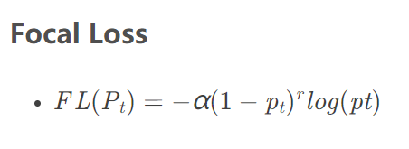
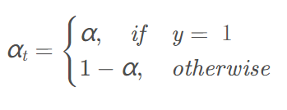
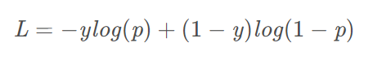
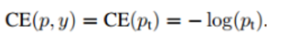
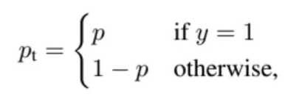
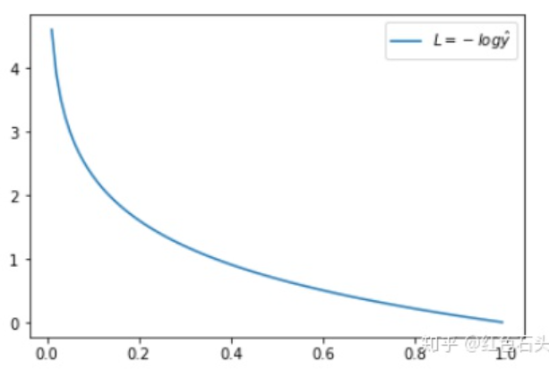
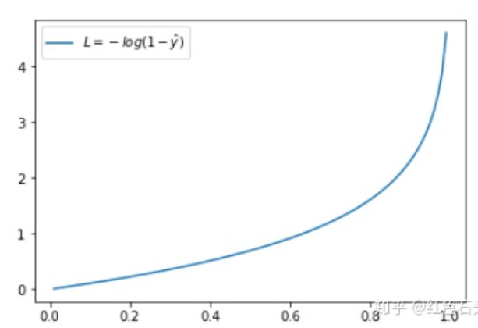
MLP from Tensor flow
—Using Focal Loss
Cross Entropy Loss
Two more hyperparameter introduced, which is the α and γ
Here the α is the weight parameter for sharing the whole loss between the positive and negative samples
A 'distance' measure of the trained model and ideal model
Here the γ is the focusing parameter, and γ>=0,and the (1-Pt)^γ is the modulating factor, we can find that when γ =0, α=0 Focal Loss will reduce to the cross entropy loss
Y =1
Y =0

Slide 35
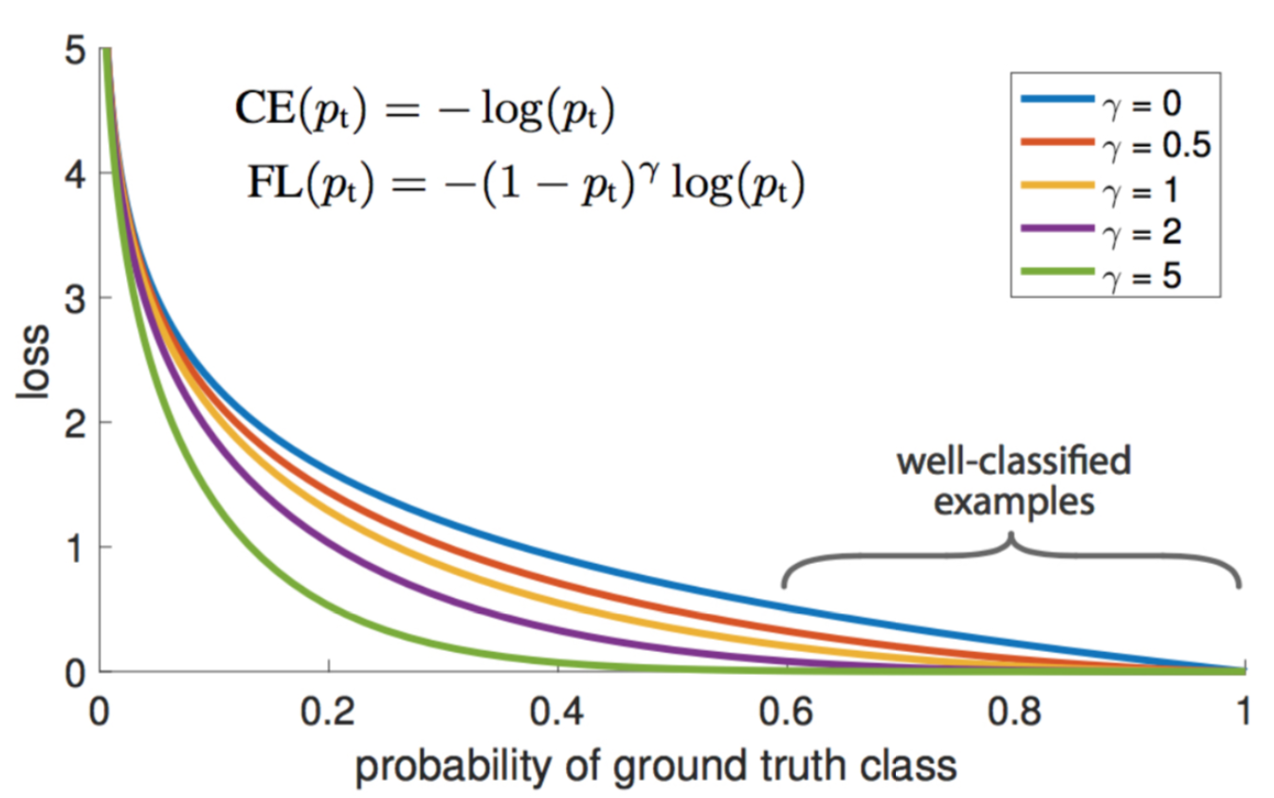
MLP from Tensor flow
—Using Focal Loss
The main idea of the focal loss is to reduce the weight of the easy classified weight and focus the model training on the hard samples
The α controls the weight of the positive and negative and the γ controls the weight of the easy classified and hard classified
When γ is certain, the same easy example (pt = 0.9) has a loss that is 100+ times smaller than the standard cross-entropy loss, but for the hard example (pt < 0.5), the loss is at most 4 times smaller. In this way the weight of hard example is relatively much higher. This increases the importance of those misclassifications

Slide 36
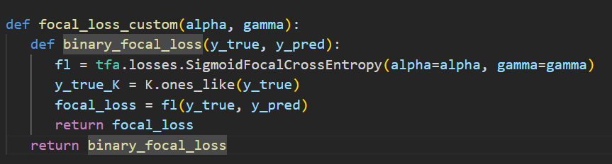
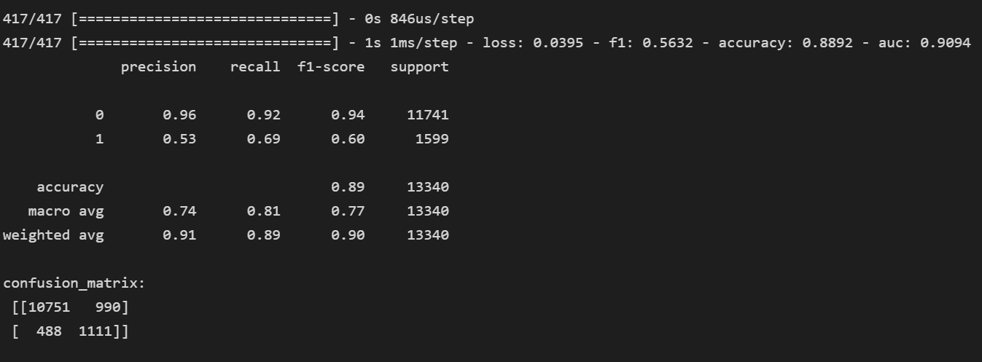
MLP from Tensor flow
—Using Focal Loss
By using the tensor flow addon package and self-defined function, we implemented the MLP using focal loss
Hyperparameters | values
Loss | Focal_loss_custom
Alpha | = 0.7
Gamma | = 2
Epochs | = 150
Batch_size | = 128

Slide 37
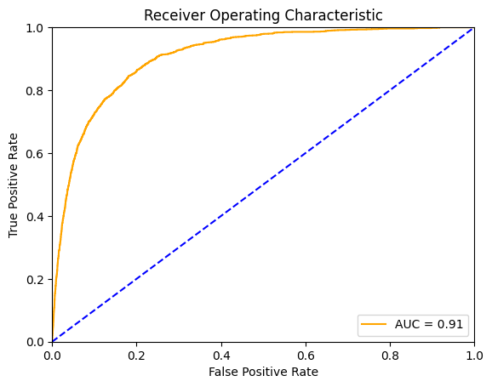
MLP from Tensor flow
—Using Focal Loss
No need to balance data
No need to alter threshold
No need to tune parameters in scrutiny to get a usable result
Comparing with the previous results using the SMOTE, our enhanced MLP model does better in f-1 score, recall of the positive

Slide 38
Summary Future Improvements
06

Slide 39
Summary —Machine Learning Methods
 | Logistic Regression | Random Forests | Naive Bayes | SVM | Voting
Accuracy | 0.89 | 0.90 | 0.87 | 0.90 | 0.89
AUC | 0.87 | 0.91 | 0.83 | 0.81 | 0.91

Slide 40
Summary —Deep Learning Methods
 | MLP Classifier | Tensor Flow ( cross entropy) | Tensor Flow ( focal loss)
Imbalanced dataset processing | Process the dataset with SMOTE | Process the dataset with SMOTE | Enhanced the model with Focal Loss
Accuracy | 0.88 | 0.89 | 0.89
AUC | 0.70 | 0.89 | 0.9
Recall | 0.46 | 0.52 | 0.69
F-1 score | 0.47 | 0.53 | 0.6

Slide 41
Future Improvements
Given that the random forests is one of the best models, we will try to stack different base estimators into ensembled methods to further improve the performance.
Tune the hyperparameters better to fit for the data set
Tune the focal loss further to fit the deep learning model
Find other loss measures for the multi- layer perception model to enhance the overall performance better
Computing power permit, we will try to vote the deep learning models

Slide 42
Thanks!
Q&A

